Slide 1
Frames of Reference

Slide 2
Types of Reference Frame:
There are two types of reference frames.
Inertial Frame of Reference
Non-Inertial Frame of Reference

Slide 3

1. Inertial Frame of Reference:
A frame of reference which is at rest or which is moving with a constant velocity along a straight line is called an inertial frame of reference. A frame of reference is one in which Newton’s laws are obeyed is called an inertial frame of reference. It does not accelerate–unlike non-inertial frames.
Inertial frame of reference is also known as Newtonian, Galilean or Unaccelerated frame of reference.
Ideally no inertial frame of reference exists in the universe.Ideally no frame of reference in this universe is totally inertial. But we consider earth as an inertial frame of reference except while observing motion of planets. In this case the sun can be assumed as an inertial frame of reference.

Slide 4

Examples of Inertial Frames of Reference:
A train moving with constant velocity
A lift moving up/down with constant velocity

Slide 5

2. Non-Inertial Frames of Reference:
An accelerated frame of reference with respect to an inertial frame is called a Non-inertial frame of reference.
Newton’s laws of motion are not valid in this frame of reference.

Slide 6

Examples of Non- Inertial Frames of Reference:
Observer moving with non-zero acceleration.
Accelerated lift moving up/down.

Slide 7
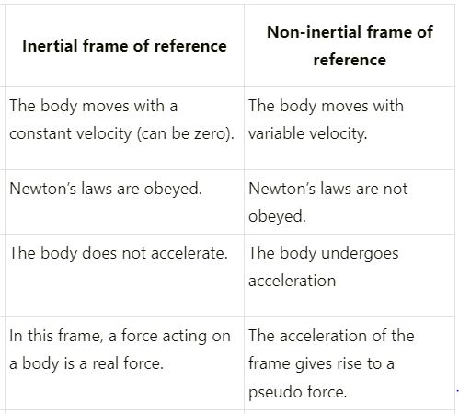
Inertial Frame Vs Non-Inertial Frame:

